Slide 1
Virtual Object Layer in HDF5
Exploring new HDF5 concepts

Slide 2
motivation

Slide 3
HDF5 Data Model
Simple model with two main objects - groups and datasets
Powerful and widely used
Wide range of applications rely on this model
Limited by the HDF5 library itself:
Local access to a single HDF5 file
HPC applications suffer performance penalties due to the required coordination for file access among multiple processes

Slide 4
Virtual Object Layer
Goal
Provide an application with the HDF5 data model and API, but allow different underlying storage mechanisms
New layer below HDF5 API
Intercepts all API calls that can touch the data on disk and routes them to a Virtual Object Driver
Potential Object Drivers (or plugins):
Native HDF5 driver (writes to HDF5 file)
Raw driver (maps groups to file system directories and datasets to files in directories)
Remote driver (the file exists on a remote machine)

Slide 5
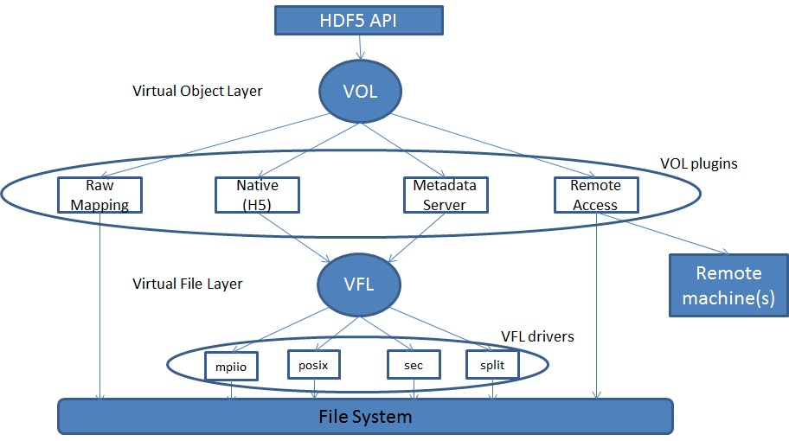
Virtual Object Layer

Slide 6
Why not use the VFL?
VFL is implemented below the HDF5 abstract model
Deals with blocks of bytes in the storage container
Does not recognize HDF5 objects nor abstract operations on those objects
VOL is layered right below the API layer to capture the HDF5 model

Slide 7
Sample API Function Implementation
hid_t H5Dcreate2 (hid_t loc_id, const char *name, hid_t type_id, hid_t space_id, hid_t lcpl_id, hid_t dcpl_id, hid_t dapl_id) {
/* Check arguments */
…
/* call corresponding VOL callback for H5Dcreate */
dset_id = H5_VOL_create (TYPE_DATASET, …);
/*
Return result to user (yes the dataset is created,
or no here is the error)
*/
return dset_id;
}

Slide 8
Design considerations

Slide 9
VOL Plugin Selection
Use a pre-defined VOL plugin:
hid_t fapl = H5Pcreate(H5P_FILE_ACCESS);
H5Pset_fapl_mds_vol(fapl, …);
hid_t file = H5Fcreate("foo.h5", …, …, fapl);
H5Pclose(fapl);
Register user defined VOL plugin:
H5VOLregister (H5VOL_class_t *cls)
H5VOLunregister (hid_t driver_id)
H5Pget_plugin_info (hid_t plist_id)

Slide 10
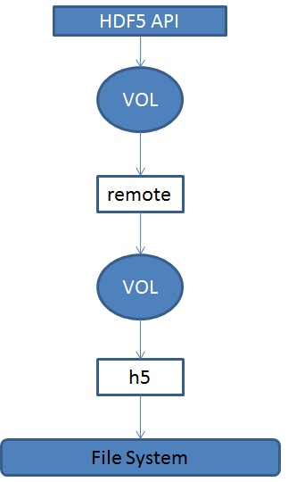
Interchanging and Stacking Plugins
Interchanging VOL plugins
Should be a valid thing to do
User’s responsibility to ensure plugins coexist
Stacking plugins
Stacking should make sense.
For example, the first VOL plugin in a stack could be a statistics plugin, that does nothing but gather information on what API calls are made and their corresponding parameters.

Slide 11
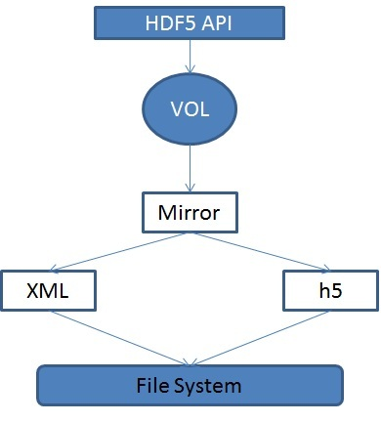
Mirroring
Extension to stacking
HDF5 API calls are forwarded through a mirror plugin to two or more VOL plugins

Slide 12
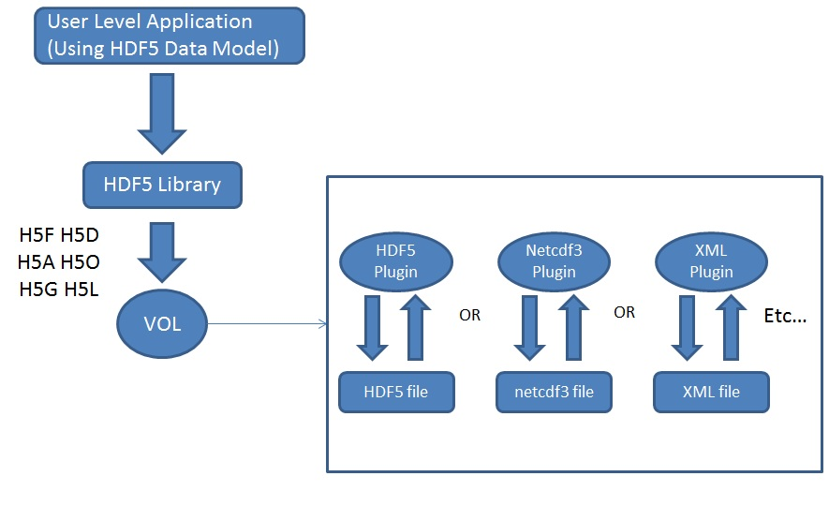
Sample Plugins (I)
Different File Format plugins

Slide 13
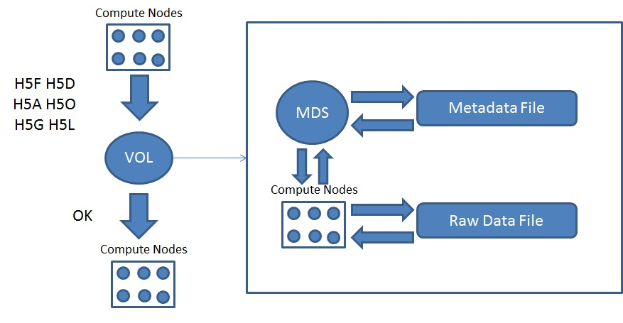
Sample Plugins (II)
Metadata Server Plugin

Slide 14
Sample Plugins: Metadata Server
Application processes
Set aside process
Compute Nodes
MDS
Metadata
H5F H5D H5A H5O H5G H5L
VOL
HDF5 container
Raw Data File
Metadata File

Slide 15
Raw Plugin
The flexibility of the virtual object layer provides developers with the option to abandon the single file, binary format like the native HDF5 implementation.
A “raw” file format could map HDF5 objects (groups, datasets, etc …) to file system objects (directories, files, etc …).
The entire set of raw file system objects created would represent one HDF5 container.
Useful to the PLFS package (http://institute.lanl.gov/plfs/)

Slide 16
Remote Plugin
A remote VOL plugin would allow access to files located remotely.
The plugin could have an HDF5 server module located where the HDF5 file resides and listens to incoming requests from a remote process.
Use case: Remote visualization
Large, remote datasets are very expensive to migrate to the local visualization system.
It would be faster to just enable in situ visualization to remotely access the data using the HDF5 API.

Slide 17
Implementation considerations

Slide 18
Implementation
VOL Class
Data structure containing general variables and a collection of function pointers for HDF5 API calls
Function Callbacks
API routines that potentially touch data on disk
H5F, H5D, H5A, H5O, H5G, H5L, and H5T

Slide 19
Implementation
We will end up with a large set of function callbacks:
Lump all the functions together into one data structure OR
Have a general class that contains all common functions, and then children of that class that contain functions specific to certain HDF5 objects OR
For each object have a set of callbacks that are specific to that object (This is design choice that has been taken).

Slide 20
Filters
Need to keep HDF5 filters in mind
Where is the filter applied, before or after the VOL plugin?
Logical guess now would be before, to avoid having all plugins deal with filters

Slide 21
Implementation Plan
The following is a tentative implementation plan
March 2012: Publish Request for Comment document (RFC) with design and implementation ideas
April/May 2012: Have the prototype VOL architecture in place inside the library
Summer 2012: Prototype implementation for the several plugins:
Metadata Server plugin
Raw Plugin
DSM Plugin
Maybe more depending on awaited funding for submitted proposals

Slide 22
Thank You!
Questions?

